Slide 1
Software Testing
Andrei Timotei
Bălan Teodor-Daniel
Comârdici Marian-Bogdan
Simion Ștefan
Vîrtopeanu Sebastian-Filip

Slide 2
Content
Equivalance class partitioning
Boundary value analysis
Control flow graph
Instruction level coverage
Decision level coverage
Condition level coverage
Independent circuits
Mutants analysis

Slide 3
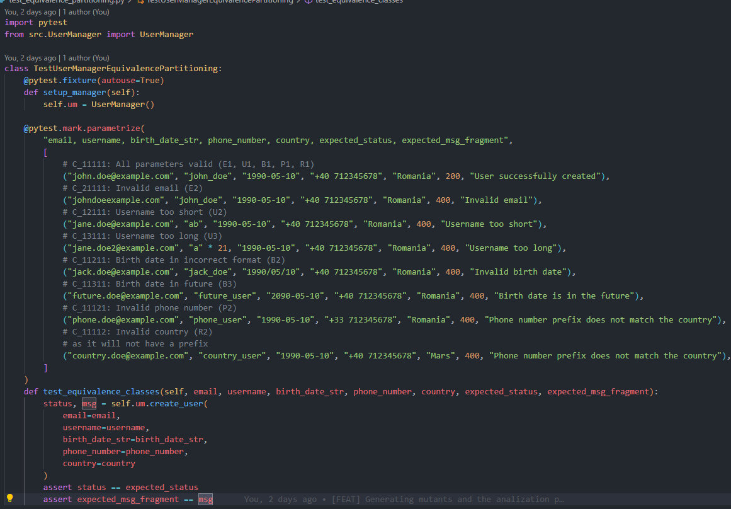
Equivalance class partitioning
Purpose: Reduces the number of test cases while maintaining effective coverage by grouping inputs that are expected to behave similarly.
Application: Used on the input validation logic for the create_user method to separate valid and invalid input classes.
Benefit: Increases testing efficiency by avoiding redundant tests, ensuring representative coverage with fewer cases.
Example:
Test 1: All parameters valid (E1, U1, B1, P1, R1) – Expected 200 OK ("User successfully created")
Test 2: Invalid email format (E2) – Expected 400 Bad Request ("Invalid email")
Test 3: Username too short (U2) – Expected 400 Bad Request ("Username too short")
Test 4: Username too long (U3) – Expected 400 Bad Request ("Username too long")
Test 5: Incorrect birth date format (B2) – Expected 400 Bad Request ("Invalid birth date")
Test 6: Birth date in the future (B3) – Expected 400 Bad Request ("Birth date is in the future")
Test 7: Phone number prefix mismatch (P2) – Expected 400 Bad Request ("Phone number prefix does not match the country")
Test 8: Invalid country (R2) – Expected 400 Bad Request ("Phone number prefix does not match the country")

Slide 4
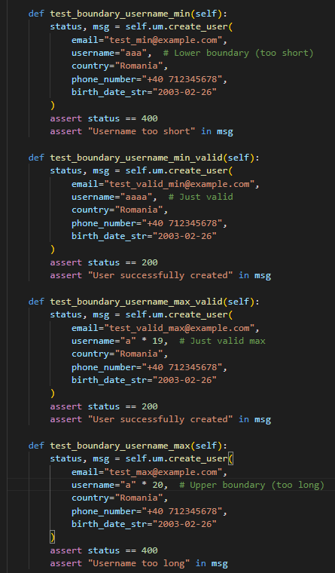
Boundary Value Analysis
Boundary Value Analysis helps uncover errors at the edges of input domains.
Often used alongside Equivalence Partitioning.
In our case, applied to the create_user method in the UserManager class.
Focused on testing minimum and maximum values for input fields.
Example - Username Length:
aaa (3 chars) → Rejected (too short)
aaaa (4 chars) → Accepted (minimum valid)
a × 19 (19 chars) → Accepted (maximum valid)
a × 20 (20 chars) → Rejected (too long)

Slide 5
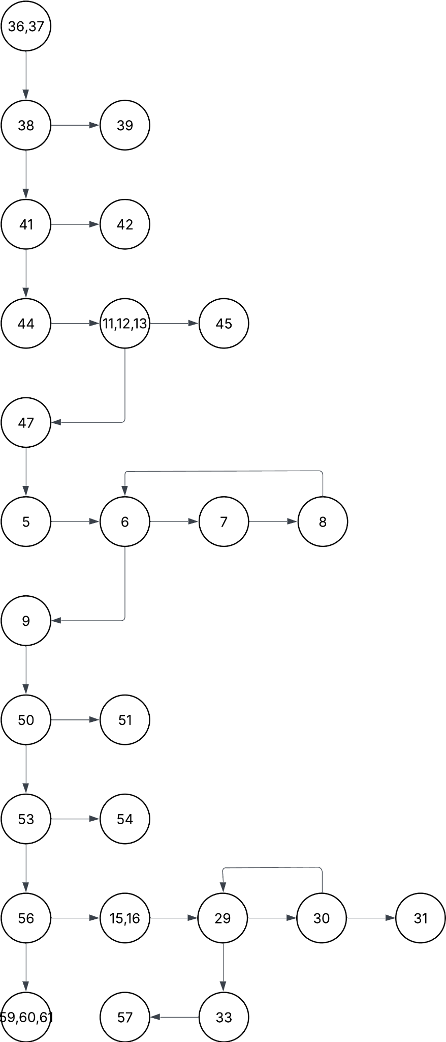
Control Flow Graph
Nodes: Represent basic blocks (a straight-line sequence of code with no branches).
Edges: Represent control flow (jumps, decisions like if, while, for, etc.).
Entry Node: Where execution begins.
Exit Node: Where execution ends.
Visualizes all execution paths through a program and helps design tests for:
Statement Coverage
Branch Coverage
Path Coverage
Aids in detecting:
Unreachable code
Dead paths
Logical errors

Slide 6
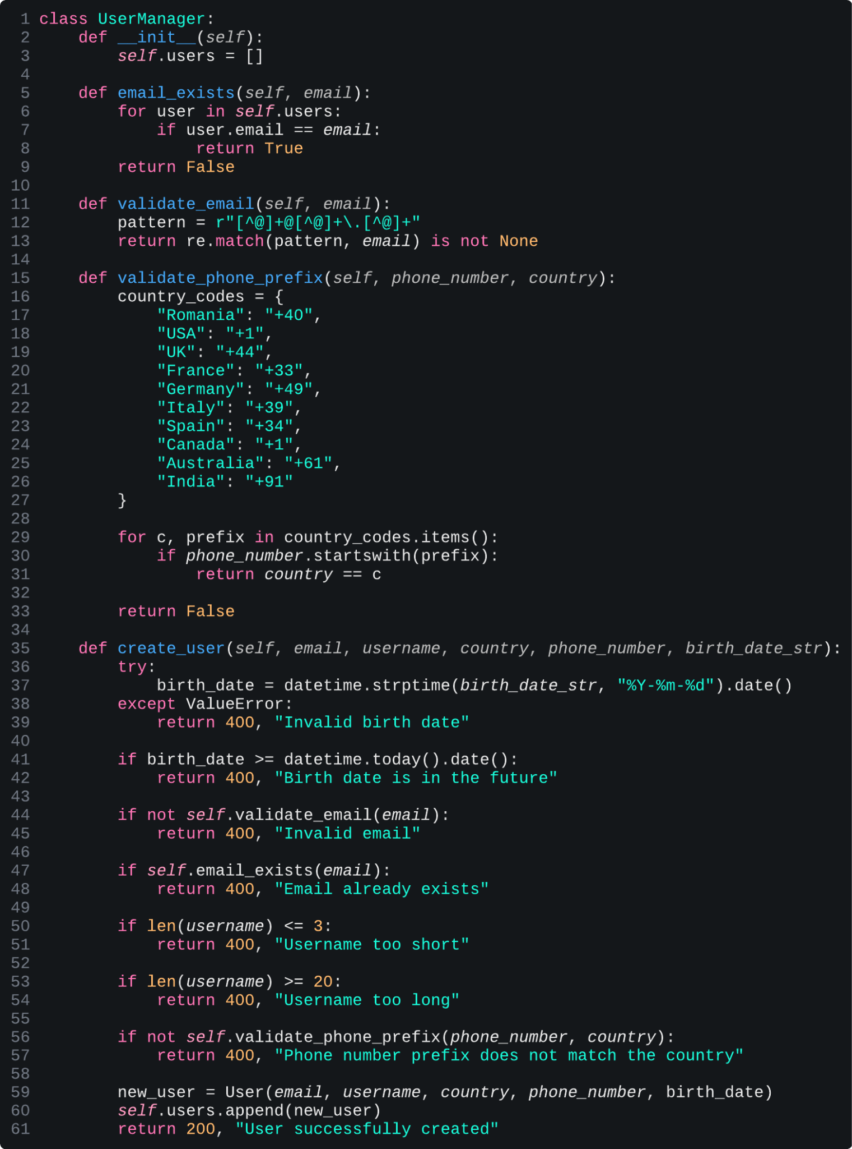
Instruction Level Coverage
Purpose: Ensures every executable instruction is run at least once during testing.
Application: Used on the create_user method in UserManager to validate all paths.
Benefit: Catches hidden bugs by covering rarely executed lines.
Result: 98% statement coverage achieved through targeted test cases.
Example:
Test 1: Valid user creation - Covers lines: 36-37, 40-41, 43-44, 46-47, 49-50, 52-53, 55-56, 58-61
Test 2: Invalid e-mail format - Covers lines: 36-37, 40-41, 43-45
Test 3: Username too short - Covers lines: 36-37, 40-41, 43-44, 46-47, 49-51

Slide 7
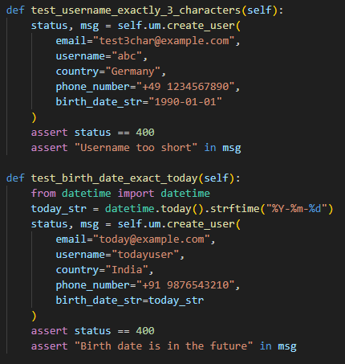
Decision-Based Coverage
Purpose: Reduces the number of test cases while ensuring all decision outcomes (true/false) are tested for every decision point in the code.
Application: Applied on the input validation logic for the create_user method to test each conditional branch like email format, username length, birth date validation, and phone prefix matching.
Benefit: Improves test effectiveness by covering all logical branches while minimizing redundant or unnecessary tests.
Example -
Test 1: All parameters valid (D1_T, D2_F, D3_F, D4_F, D5_F, D6_T, D7_T) – Expected 200 OK ("User successfully created")
Test 2: Invalid email format (D1_F) – Expected 400 Bad Request ("Invalid email")
Test 3: Duplicate email (D2_T) – Expected 400 Bad Request ("Email already exists")
Test 4: Username too short (D3_T) – Expected 400 Bad Request ("Username too short")
Test 5: Username too long (D4_T) – Expected 400 Bad Request ("Username too long")
Test 6: Birth date in future (D5_T) – Expected 400 Bad Request ("Birth date is in the future")
Test 7: Birth date wrong format (D6_F) – Expected 400 Bad Request ("Invalid birth date")
Test 8: Phone prefix does not match country (D7_F) – Expected 400 Bad Request ("Phone number prefix does not match the country")

Slide 8
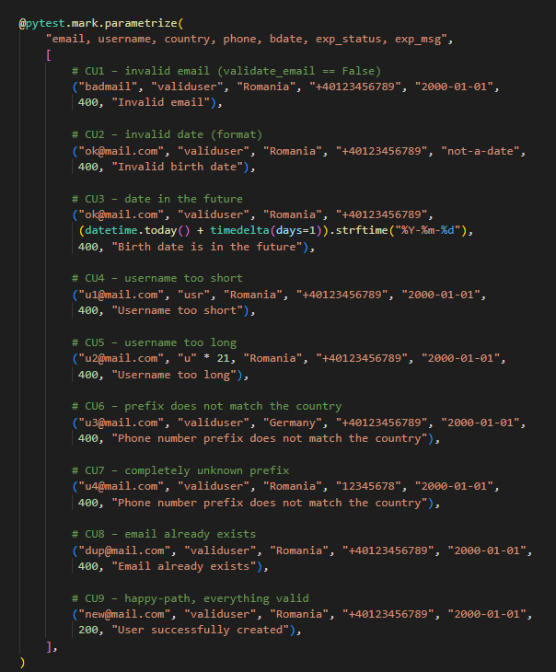
Condition level coverage
Purpose: Ensures that every atomic Boolean condition inside compound decisions is evaluated to both True and False at least once during testing.
Application: Applied to the create_user method in UserManager to guarantee that each logical check (email format, duplicate email, birth date validation, username length, phone-country matching) behaves correctly in all Boolean permutations.
Benefit: Improves detection of subtle logic flaws in compound conditions by testing the internal structure of decision logic—not just their overall result.
Difference from Decision Coverage:
While decision (branch) coverage verifies that each full if or control expression evaluates both ways, condition coverage drills deeper—it verifies that each individual Boolean part of a decision is exercised in both states.

Slide 9
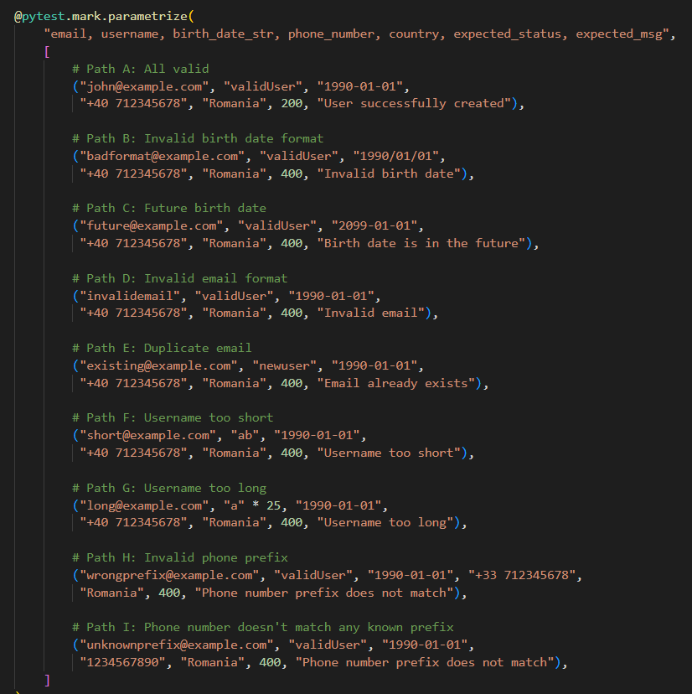
Independent Circuits
Purpose: Ensures each unique logic path in the code is tested independently, providing full branch coverage.
Application: Applied to the create_user method in UserManager by designing tests for each independent path identified via control flow analysis.
Benefit: Improves test accuracy and coverage by isolating logic errors, using McCabe’s Cyclomatic Complexity to guide the number of required paths.
Cyclomatic Complexity Analysis: V(G) = e - n + 2
➤ Simplified formula underestimated complexity (V(G) = 1)
➤ Adjusted approach using predicate nodes:
V(G) = Number of decisions + 1 = 8 + 1 = 9
Result: 9 independent circuits identified for complete coverage.

Slide 10
Mutants Analysis
Purpose: Evaluates the effectiveness of tests by introducing small changes (mutations) and checking if tests detect them.
Application: Used mutmut v2.5.2 to generate mutants for the UserManager codebase; version 2.x chosen for HTML report support.
Benefit: Identifies weak spots in the test suite that allow bugs to survive; improves overall test robustness.
Result: Increased killed mutants from 6/56 to 53/56 after enhancing the test coverage.
Detected Issue 1: Wrong country code mapping
✅ Solution: Added parameterized test for all country codes.
Detected Issue 2: Incorrect error message mutation
✅ Solution: Improved assertions to check exact error messages.
Final status: 56 mutants killed.

Slide 11
Mulțumim!

